Slide 1
8255 Programmable Peripheral Interface (PPI)

Slide 2
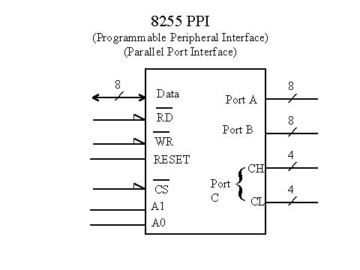
8255 Programmable Peripheral interface

Slide 3
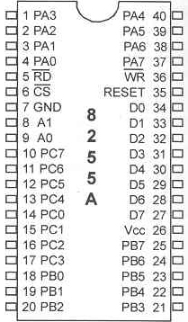
8255 PPI Chip

Slide 4
8255 Port Selection
CS’ | A1 | A0 | Selects
0 | 0 | 0 | PORT A
0 | 0 | 1 | PORT B
0 | 1 | 0 | PORT C
0 | 1 | 1 | CONTROL WORD
1 | X | X | 8255 NOT SELECTED
CS (chip select) : select the
entire chip
A0 and A1 : select the specific
port with the 8255.

Slide 5
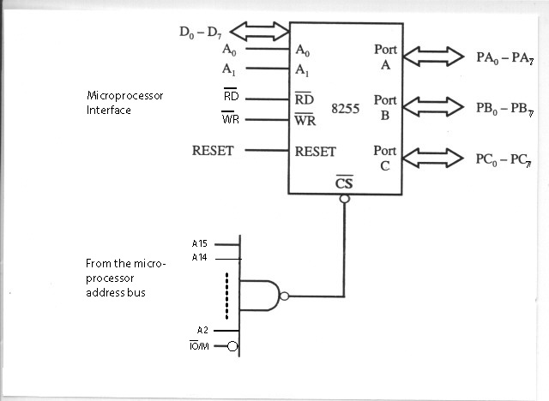
Addressing 8255

Slide 6
Mode Selection of the 8255
Ports A, B, and C are used for I/O data.
The control register is programmed to select the
operation mode of the three ports A, B, and C.
Mode 0 : simple I/O mode
Any of the ports A, B, CL and CU can be programmed as input or output.
No control of individual bits (all bits are out or all bits are in)
Mode 1 : Ports A and B can be used as input or output ports with handshaking.
Mode 2 : Port A can be used as bidirectional I/O port with handshaking.

Slide 7
The 8255 Programmable Peripheral Interface (PPI)
It is one of the most widely used I/O chips.
It has three separately accessible ports: A, B, and C
The individual ports can be programmed to be input or output.
Port A (PA0-PA7) -> all inputs or all outputs.
Port B (PB0-PB7) -> all inputs or all outputs.
Port C (PC0-PC7) -> all inputs or all outputs or can be programmed individually.
CU : upper bits (PC4-PC7)
CL : lower bits (PC0-PC3)

Slide 8
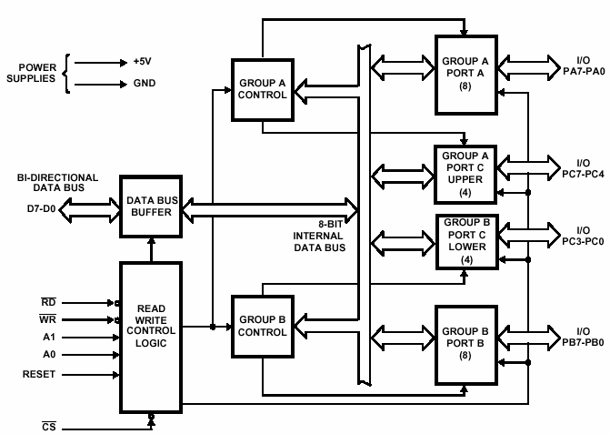
Block Diagram of the 8255

Slide 9
RD’ | WR’ | CS’ | A1 | A0 | Input (Read Cycle)
0 | 1 | 0 | 0 | 0 | Port A to Data bus
0 | 1 | 0 | 0 | 1 | Port B to Data bus
0 | 1 | 0 | 1 | 0 | Port C to Data bus
0 | 1 | 0 | 1 | 1 | CWR to Data bus
RD’ | WR’ | CS’ | A1 | A0 | Output (write Cycle)
1 | 0 | 0 | 0 | 0 | Data bus to Port A
1 | 0 | 0 | 0 | 1 | Data bus to Port B
1 | 0 | 0 | 1 | 0 | Data bus to Port C
1 | 0 | 0 | 1 | 1 | Data bus to CWR
RD’ | WR’ | CS’ | A1 | A0 | Function
X | X | 1 | X | X | Data bus tristated
1 | 1 | 0 | X | X | Data bus tristated

Slide 10
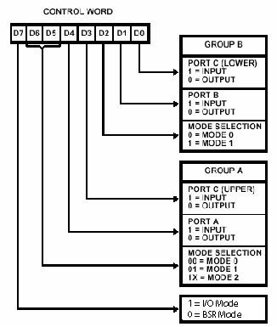




I/O Mode of the 8255
D7 = 0 -> BSR (bit set/reset) mode,
the bits of port C are programmed
individually.

Slide 11
Input/output Data Transfers
Data transfers can be Byte-wide or word-wide.
The accessed I/O port is selected by an I/O address.
The I/O address is specified as part of the I/O instruction.
The 8086 I/O addresses are output on address/data bus lines AD0-AD15.
The logic levels of signals A0 and BHE determine whether data are I/O for an odd addressed byte-wide port, even-addressed byte wide port, or word-wide port.

Slide 12
Input/output Instructions
Mnemonic | Meaning | Format | Operation
IN | Input direct Input indirect (variable) | IN ACC, Port IN ACC, DX | ACC<-[Port] ; ACC = AL or AX ACC<-[DX]
OUT | Output direct Output indirect (variable) | OUT Port, ACC OUT DX, ACC Output direct | [Port] <-ACC [DX] <-ACC
Direct: port address is specified directly and cannot be larger than FFH.
Ex. IN AL, 99H ; bring a byte into AL from port 99H
OUT 34H, AX ; send out a word from AX to port addresses 34H -35H
Register indirect: the port address is kept by the DX register. Therefore, it can be as high
as FFFFH.
Ex. MOV DX, 64B1H ; DX = 64B1H
OUT DX, AX ; send out a word from AX to port address pointed to DX.
; The byte from AL goes to port 64B1H and byte from AH
; goes to port 64B2H

